Slide 1
Lesson 3.6 Impacts of Oil Spills
CGPRT(W) : Ensuring Clean Seas and Coasts in Western Region ……

Slide 2
Objective
To recognize potential impacts of oil spills.
To use this information to elaborate the overall response strategy.
CGPRT(W) : Ensuring Clean Seas and Coasts in Western Region ……

Slide 3
Impacts of Oil Spills
Oil spills can adversely impact:
Health and safety due to oil toxicity
Social and economic activities
Marine and coastal environment
Impacts can be from:
Interference with activities
Oil toxicity
Smothering
CGPRT(W) : Ensuring Clean Seas and Coasts in Western Region ……

Slide 4
Oil Toxicity
Will depend on:
Oil type and concentration
Exposure duration
Sensitivity of organisms
Toxic components:
Polycyclic Aromatic Hydrocarbons (PAHs)
Light fractions
BETX (Benzene, Ethylene, Toluene, Xylene)
Heavy metals
CGPRT(W) : Ensuring Clean Seas and Coasts in Western Region ……

Slide 5
Oil Toxicity
Generally:
Light oil: effects are from oil toxicity
Heavy oil: effects are from smothering of organisms
CGPRT(W) : Ensuring Clean Seas and Coasts in Western Region ……

Slide 6
Acute Effects
Heavy and medium crude oil
Smothering of organism
Asphyxia
Light components
Ingestion or inhalation
Contamination of flesh
CGPRT(W) : Ensuring Clean Seas and Coasts in Western Region ……

Slide 7
Chronic Effects
Physiological problems
Decrease productivity
Slower growth
Decrease olfactive capacity (marine mammals)
Behavioural disruption
Slower reaction time
Feeding problems
Reproductive problems
Bioaccumulation/depuration
CGPRT(W) : Ensuring Clean Seas and Coasts in Western Region ……

Slide 8
Impacts of Oil
Important to differentiate between impacts on individuals and those on population
A few individuals may suffer severe adverse effects with no impacts to overall population.
Impacts from oil have been studied since the first major shipping incidents.
Generally, short term impacts with moderate to low long term impacts.
CGPRT(W) : Ensuring Clean Seas and Coasts in Western Region ……

Slide 9
Factors Affecting the Impact of Oil
Type of oil and degree of weathering
Biological characteristics of the area
Geographic location
Degree of oiling
Oceanographic and meteorological conditions
Season
Choice of response strategy and effectiveness of response
CGPRT(W) : Ensuring Clean Seas and Coasts in Western Region ……

Slide 10
Costs of Incidents
In addition to the impacts of incidents from a socio-economic and environmental perspective consider the costs of an incident:
BRAER (1993): GBP 51 M*
ERIKA (1999): Eur 129.7 M*
PRESTIGE (2002): Eur 121.8 M*
DEEPWATER HORIZON (2010): US$ 40 B (estimate)**
CGPRT(W) : Ensuring Clean Seas and Coasts in Western Region ……

Slide 11
Impacts on Social and Economic Activities
CGPRT(W) : Ensuring Clean Seas and Coasts in Western Region ……

Slide 12
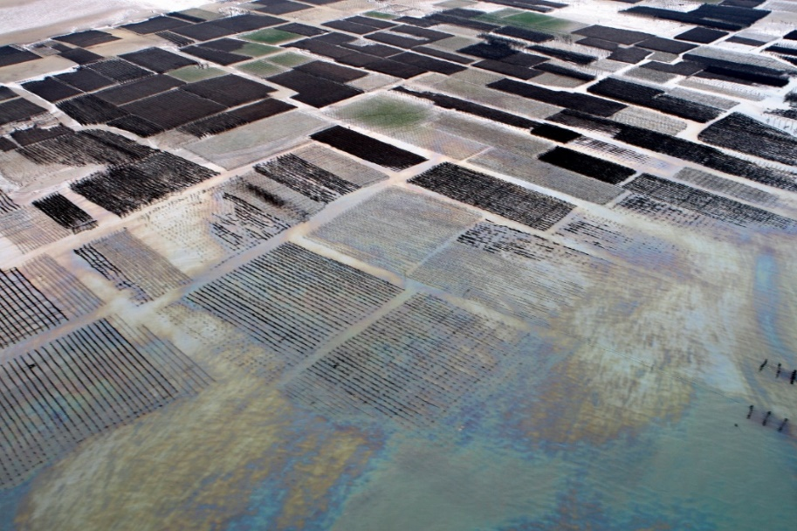
Social and Economic Activities
Presence of oil will interfere with normal activities
Can cause financial losses and loss of enjoyment
All coastal activities can be impacted
CGPRT(W) : Ensuring Clean Seas and Coasts in Western Region ……

Slide 13
Social and Economic Activities
Impacts on tourism:
Important for many coastal communities
Direct oil impacts on beaches and coastal structures can lead to closures
Potentially fewer clients for restaurants, hotels, water parks, etc.
Positive financial impacts from oil spill workers
Impacts are generally short-lived and activities resume following clean-up, however there can be significant image damage that may persist
CGPRT(W) : Ensuring Clean Seas and Coasts in Western Region ……

Slide 14
Social and Economic Activities
Impacts on water intakes:
Many industries need water to function properly:
Power and desalination plants
Fish plant
Aquarium, pools, etc.
Oil in a water intake can lead to contamination of water supply, malfunctions, etc.
Can have serious implications, e.g. power plant
Important to protect these areas to avoid contamination
CGPRT(W) : Ensuring Clean Seas and Coasts in Western Region ……

Slide 15
Social and Economic Activities
Impacts on ports and marina:
Ports are the entrance or exit for many essential goods and trade
Ports and marinas can be affected by:
Navigation channels closed or restricted
Contamination of structures such as wharf, jetties, etc.
Contamination of vessels
Closure or limited access due to response operations (booms)
Cleaning of vessels is often required
Contaminated structures can be difficult to clean
CGPRT(W) : Ensuring Clean Seas and Coasts in Western Region ……

Slide 16
Social and Economic Activities
Impacts on coastal communities:
In many parts of the world, populations live near or on the coast
Exposure to oil vapours can cause breathing difficulties, headaches and nausea
Usually, vapours are present at the beginning of a spill and the impact is likely to be short-lived
Daily activities can be impacted by the presence of oil and by response operations
CGPRT(W) : Ensuring Clean Seas and Coasts in Western Region ……

Slide 17
Social and Economic Activities
Impacts on archaeological sites and coastal artefacts:
Many archaeological sites and associated artefacts are found in coastal areas.
These areas can be contaminated by direct contact with oil.
These areas are very sensitive and clean-up methods must be adapted to preserve these sites.
Archaeologists are required to identify these areas and to provide recommendations for clean-up
CGPRT(W) : Ensuring Clean Seas and Coasts in Western Region ……

Slide 18
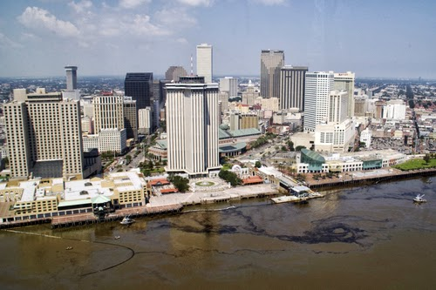
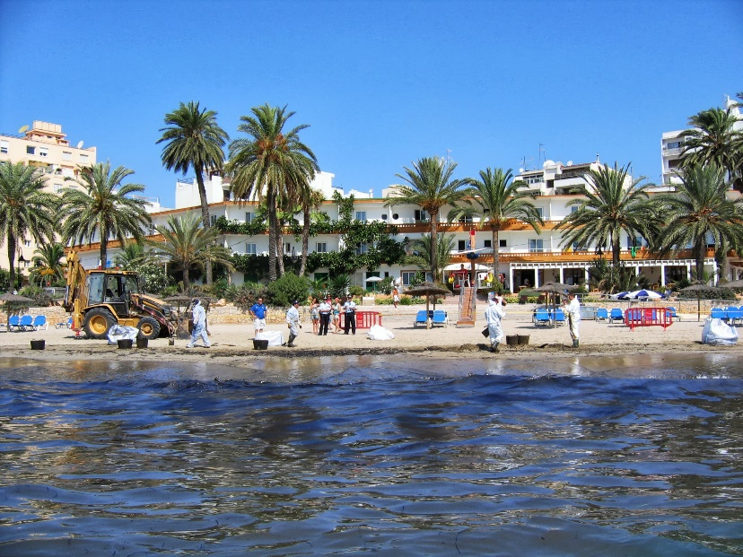
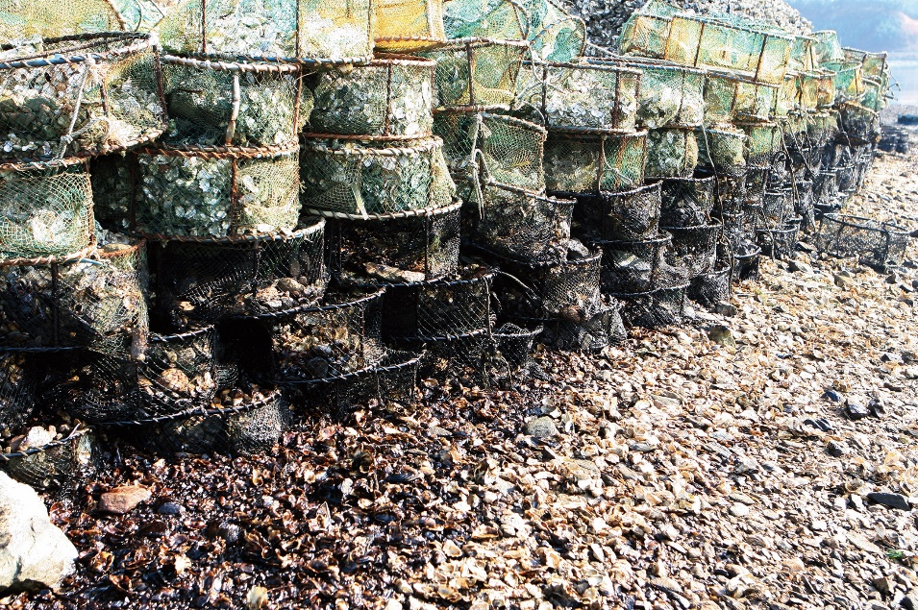
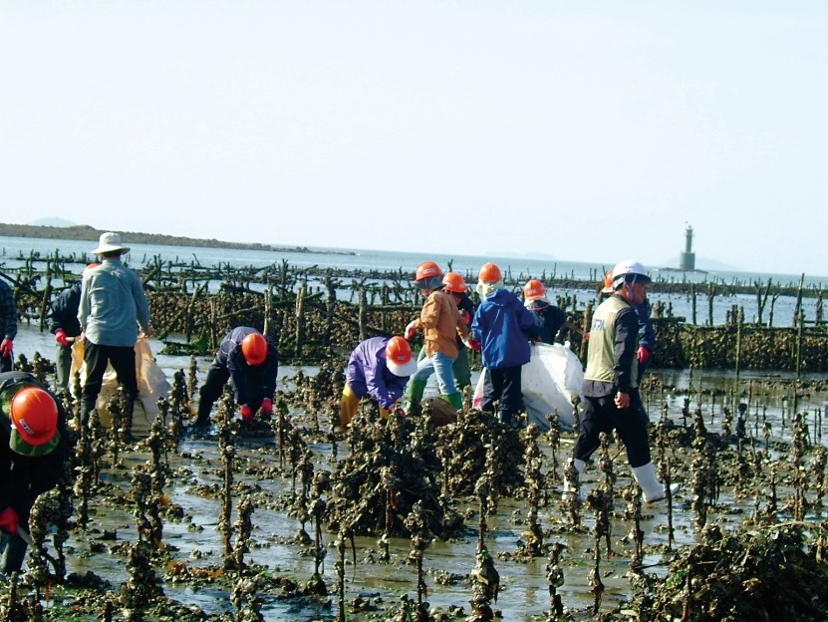
Social and Economic Activities
CGPRT(W) : Ensuring Clean Seas and Coasts in Western Region ……

Slide 19
Impacts on Marine Environment
CGPRT(W) : Ensuring Clean Seas and Coasts in Western Region ……

Slide 20
Impacts on Marine Environment
Plankton
Very sensitive to oil
Affected by dispersed oil (naturally or chemically)
Mortality is compensated by over-production of young life stage and recruitment from non-affected area
Significant decline has not been observed following an oil spill
CGPRT(W) : Ensuring Clean Seas and Coasts in Western Region ……

Slide 21
Impacts on Marine Environment
Fish
Juveniles susceptible to oil exposure
Adults more resilient, free-swimming fish will avoid oil
Mortality associated with localized conditions
Dispersed oil (naturally or chemically)
Shallow waters, light oil
Depuration processes
Generally low impacts on fish population
CGPRT(W) : Ensuring Clean Seas and Coasts in Western Region ……

Slide 22
Impacts on Marine Environment
Marine mammals
Whales, dolphins, seals, otters, manatees, etc.
Species surfacing to breath can be exposed to floating oil
Irritation to airways, eyes has been reported
Generally no mortalities but may be exceptions
Species using the shoreline such as seals and otters can suffer from oil exposure especially if their haul-out is contaminated
CGPRT(W) : Ensuring Clean Seas and Coasts in Western Region ……

Slide 23
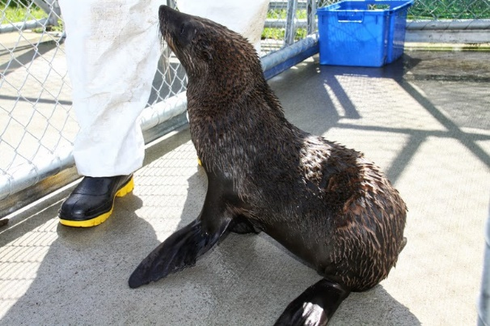
Impacts on Marine Environment
Marine mammals
Furry animals can suffer from hypothermia if the fur is oiled
Generally, impacts are mild with skin irritations and disruption the most reported
Mortality is usually rare following an oil spill
CGPRT(W) : Ensuring Clean Seas and Coasts in Western Region ……

Slide 24
Impacts on Marine Environment
Sea turtles
All species are endangered
They are vulnerable to oil particularly during nesting season and in shallow waters
They use sand beaches for nesting and to lay eggs so clean-up of these areas during nesting season will be high priority
Adults can suffer irritation and inflammation of membranes
It is possible to clean sea turtles
CGPRT(W) : Ensuring Clean Seas and Coasts in Western Region ……

Slide 25
Impacts on Marine Environment
Seabirds, wildfowl and waders
Are vulnerable to floating oil
Large numbers can die from contact with floating oil at sea or on shorelines
Oil disrupts the feathers, affecting insulation properties which results in hypothermia
Birds will also ingest oil as they attempt to clean their feathers
Exhaustion resulting from smothering, particularly following exposure to viscous oils, is a commonly observed effect
CGPRT(W) : Ensuring Clean Seas and Coasts in Western Region ……

Slide 26
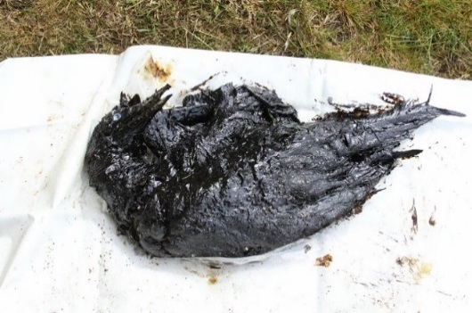
Impacts on Marine Environment
Seabirds, wildfowl and waders
Contamination of habitat especially during nesting season can cause significant impacts
Oiled birds can be cleaned and rehabilitated but depending on species it may be that only a small fraction will survive
Short and long-term damage is possible for individuals and population
CGPRT(W) : Ensuring Clean Seas and Coasts in Western Region ……

Slide 27
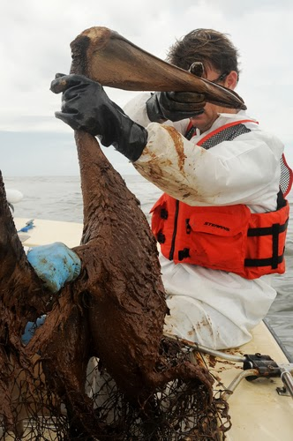
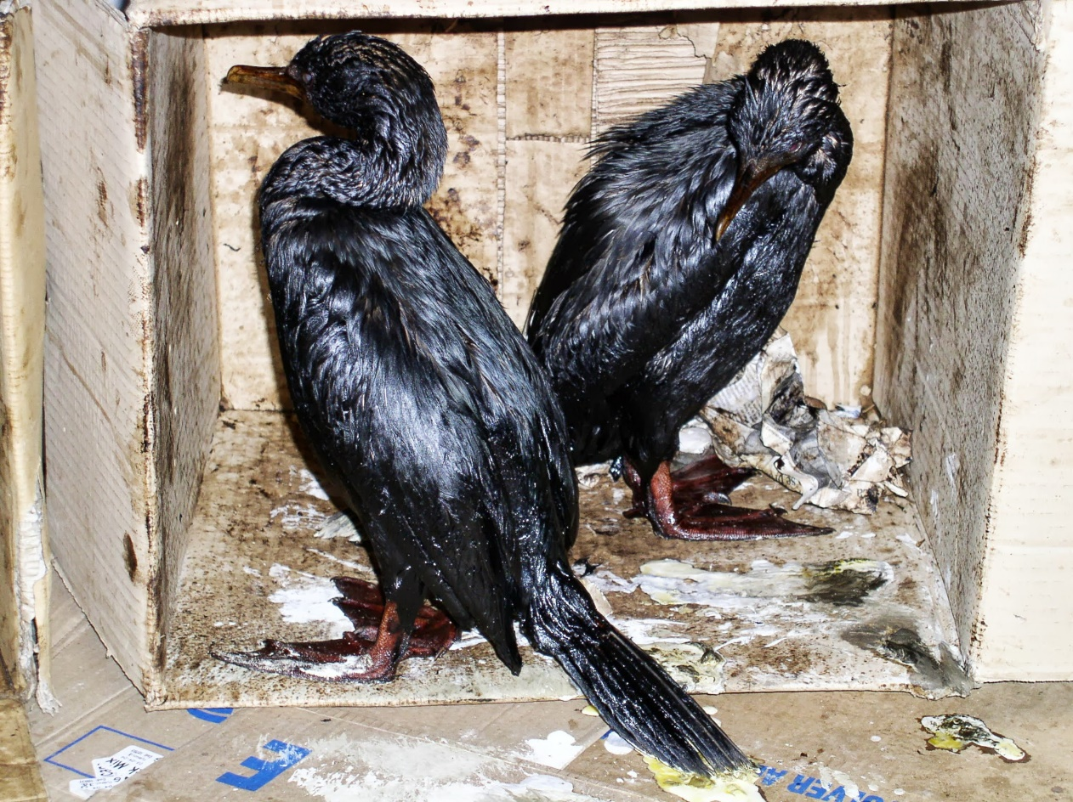
Impacts on Marine Environment
Seabirds, wildfowl and waders
CGPRT(W) : Ensuring Clean Seas and Coasts in Western Region ……

Slide 28
Impacts on Marine Environment
Corals
Highly sensitive organisms
Long recovery time if exposed to oil
Can be exposed to dispersed oil especially near shore with high energy breaking waves
Exposed coral reef can be affected by floating oil
High priority areas for protection
CGPRT(W) : Ensuring Clean Seas and Coasts in Western Region ……

Slide 29
Impacts on coastal environment
CGPRT(W) : Ensuring Clean Seas and Coasts in Western Region ……

Slide 30
Impacts on Coastal Environment
Shorelines
Shorelines are almost always impacted during an oil spill
Degree of sensitivity to oil is very variable between shoreline types
Impact is related to oil persistence and biological activity
CGPRT(W) : Ensuring Clean Seas and Coasts in Western Region ……

Slide 31
Impacts on Coastal Environment
Mangroves
Highly sensitive to oil
Trees suffer from asphyxia from oil coating of roots and pores
Clean-up is extremely difficult and recovery can take decades
CGPRT(W) : Ensuring Clean Seas and Coasts in Western Region ……

Slide 32
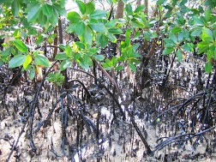
Impacts on Coastal Environment
Mangroves
CGPRT(W) : Ensuring Clean Seas and Coasts in Western Region ……

Slide 33
Impacts on Coastal Environment
Marshes
High biological importance
Plants are relatively resistant to oiling
Will depend on growth cycle
Long-term impacts due to oil penetration in the substrate affecting the root system
Penetration is generally caused by trampling or use of mechanical equipment
Needs to be considered on a case-by-case basis
CGPRT(W) : Ensuring Clean Seas and Coasts in Western Region ……

Slide 34
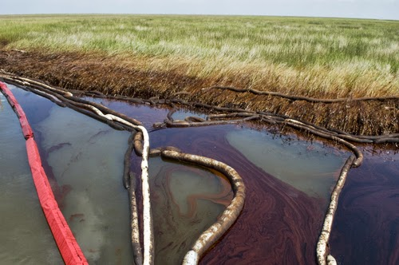
Impacts on Coastal Environment
Marshes
CGPRT(W) : Ensuring Clean Seas and Coasts in Western Region ……

Slide 35
Impacts on Coastal Environment
Mud flats
Used by many vertebrate and invertebrate species
Low energy shoreline
Long-term impacts are generally caused by oil penetration in sediments caused by trampling or oil penetration through worm burrows
CGPRT(W) : Ensuring Clean Seas and Coasts in Western Region ……

Slide 36
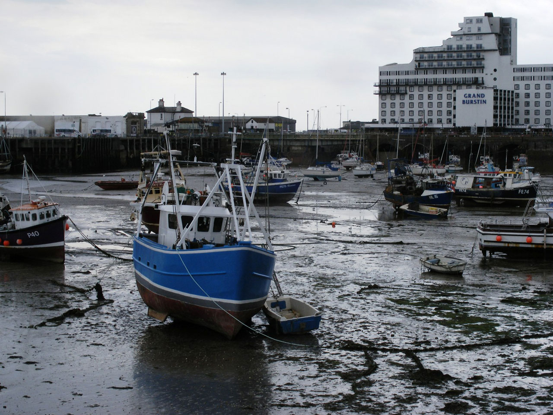
Impacts on Coastal Environment
Mud flats
CGPRT(W) : Ensuring Clean Seas and Coasts in Western Region ……

Slide 37
Impacts on Coastal Environment
Rocky shorelines
Less biologically active
Usually, they are colonized by algae or small invertebrates
Recolonization can be rapid following an oil spill
Short-term impacts are typical for these shorelines
CGPRT(W) : Ensuring Clean Seas and Coasts in Western Region ……

Slide 38
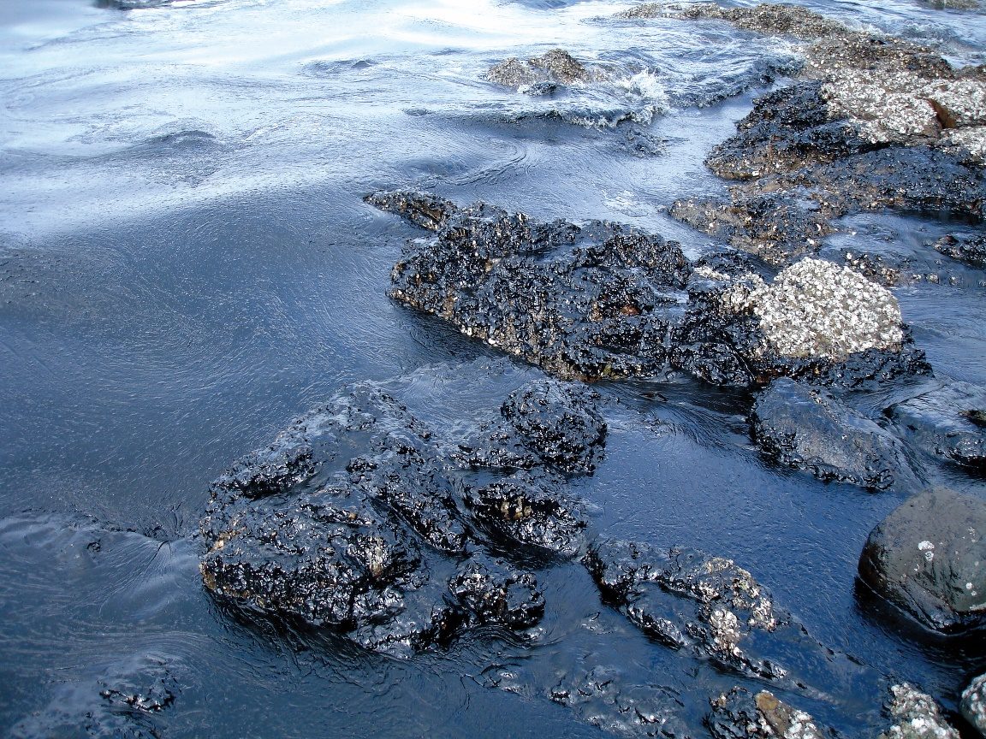
Impacts on Coastal Environment
Rocky shoreline
CGPRT(W) : Ensuring Clean Seas and Coasts in Western Region ……

Slide 39
Impacts on Coastal Environment
Sandy shorelines
Less biologically active
Short-term impacts are typical for these shorelines
Potential for oil burial due to sand movement
Potential for oil and sand interaction in the inter-tidal zone leading to sunken oil
CGPRT(W) : Ensuring Clean Seas and Coasts in Western Region ……

Slide 40
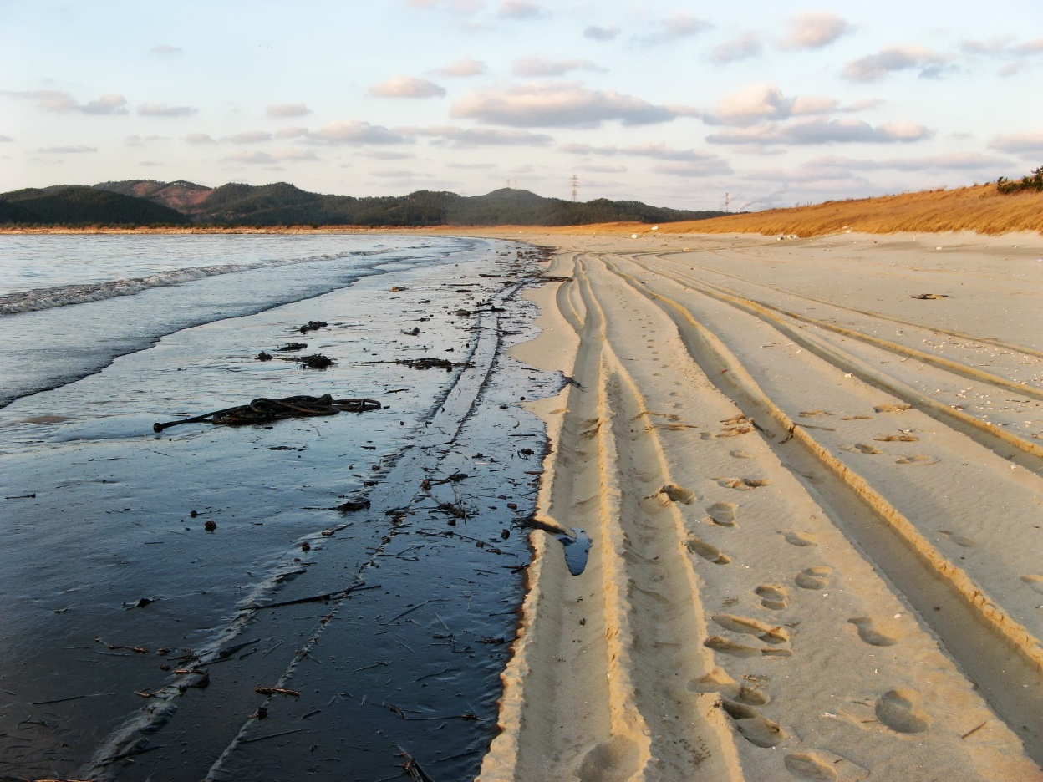
Impacts on Coastal Environment
Sandy shoreline
CGPRT(W) : Ensuring Clean Seas and Coasts in Western Region ……

Slide 41
Impacts on Marine Environment
Post-spill studies
Various studies can be undertaken to evaluate environmental damage
Chemical analysis, population inventories, etc.
Should have clear objectives and achievable goals
Importance of pre-spill background data
Restoration measures can be identified and implemented in some cases
CGPRT(W) : Ensuring Clean Seas and Coasts in Western Region ……

Slide 42
Impacts Affecting Operational Response
The impacts of oil spills on the various activities and environments can affect the operational response
Public/media attention to operational activities especially in areas of high population density
Access restrictions due to the impact’s proximity to sensitivities such as cultural sites, private property, etc.
Seasonal restrictions due to wildlife nesting, etc.
Prioritization of operational activities
CGPRT(W) : Ensuring Clean Seas and Coasts in Western Region ……

Slide 43
Impacts on Fisheries
CGPRT(W) : Ensuring Clean Seas and Coasts in Western Region ……

Slide 44
Impacts on Fisheries
Fisheries and mariculture are important economic and subsistence activities.
Fisheries can be affected by oil because of:
Smothering
Toxicity
Tainting (oil taste in flesh)
Business disruption.
CGPRT(W) : Ensuring Clean Seas and Coasts in Western Region ……

Slide 45
Impacts on Fisheries
Mariculture is particularly vulnerable
Animals cannot escape
Oiling of equipment
Some species will eliminate oil over time (depuration)
Free-swimming fish are rarely affected unless they are exposed to dispersed oil
CGPRT(W) : Ensuring Clean Seas and Coasts in Western Region ……

Slide 46
Impacts on Fisheries
Many concerns when fisheries are affected:
Public health concerns
Toxic compounds (PAHs) in flesh
Many international guidelines
Market confidence
Sales might be affected even if fish are not contaminated by oil
Fisheries closure
Often implemented during an oil spill
CGPRT(W) : Ensuring Clean Seas and Coasts in Western Region ……

Slide 47
Impacts on Fisheries
Management strategies:
Organoleptic testing
Detect taste and odours of oil in flesh
Sampling and chemical analysis
Detection of toxic compounds in flesh
Compare results with public health guidelines
Marketing campaign to restore confidence
CGPRT(W) : Ensuring Clean Seas and Coasts in Western Region ……

Slide 48
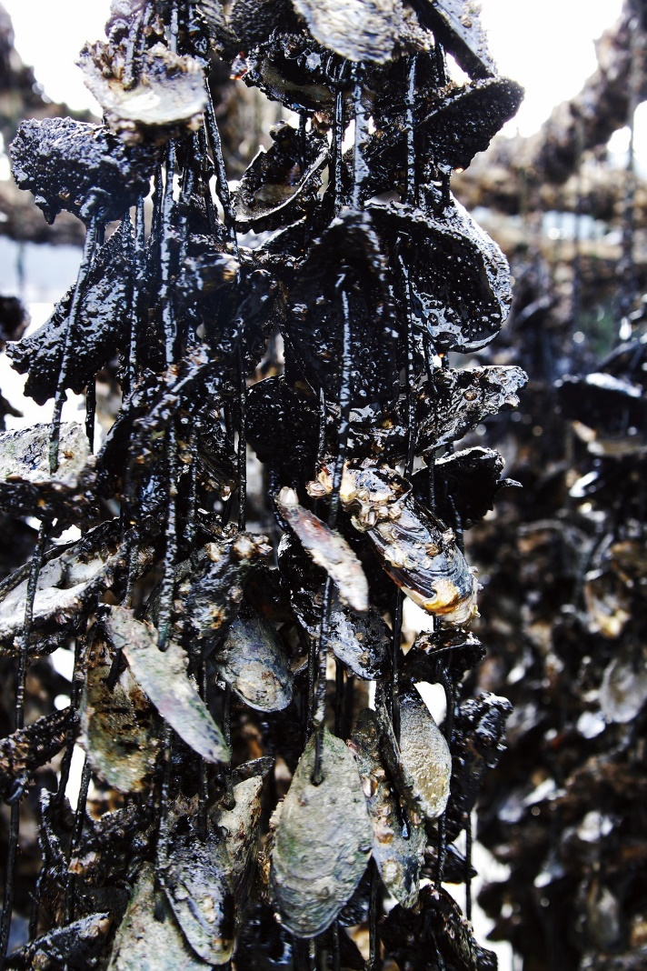
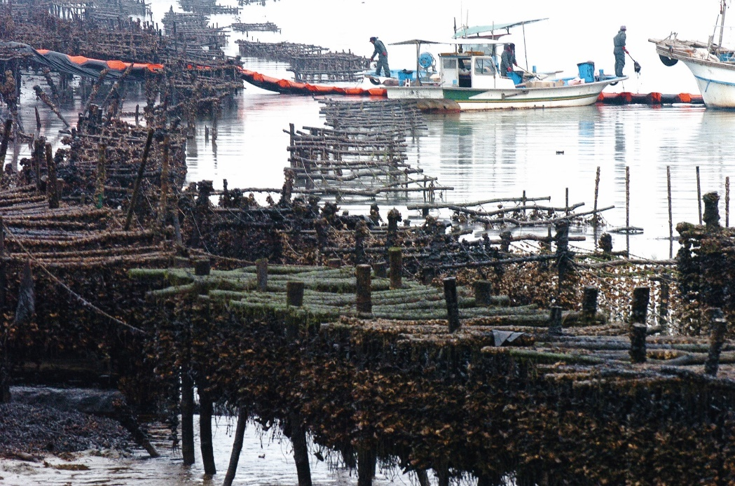
Impacts on Fisheries
CGPRT(W) : Ensuring Clean Seas and Coasts in Western Region ……

Slide 49
Points to Remember
Oil spills interfere with coastal activities
Effects on marine life are caused by:
physical contamination and smothering
tainting as a result of the smothering and toxic effects
Health of populations is more important than individuals
CGPRT(W) : Ensuring Clean Seas and Coasts in Western Region ……

Slide 50
Points to Remember
Recovery time is highly variable.
Clean-up techniques can cause further damages.
Identify and prioritize areas to be protected at contingency planning stage.
CGPRT(W) : Ensuring Clean Seas and Coasts in Western Region ……

Slide 51
Any questions?
CGPRT(W) : Ensuring Clean Seas and Coasts in Western Region ……

